Slide 1
ENGR 1182 – Fundamentals of Engineering Graphics Preparation 08 – Engine Frame

Slide 2
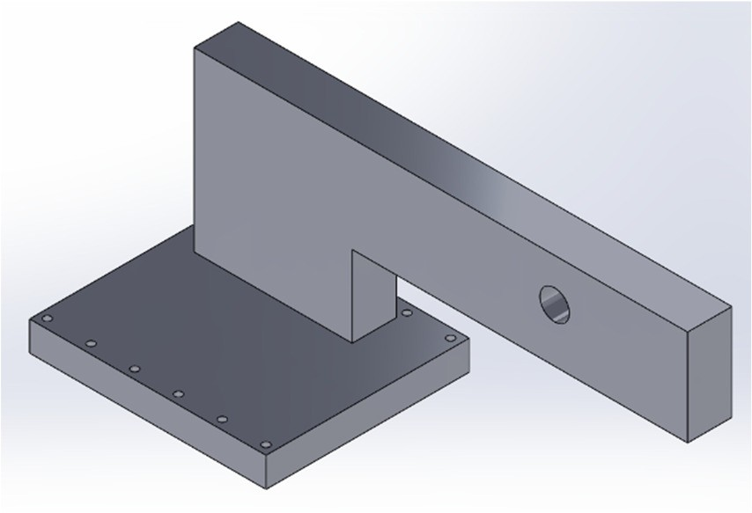
Part to be created: Engine Frame Mounting Holes
Purpose: Modify an existing part in SolidWorks.
Description: Follow the SolidWorks tutorial to create the part to the right.
Deliverables: A revised engine frame part submitted using standard submission practices for parts.

Slide 3
SolidWorks Skills Developed:
Creating linear repeated patterns
Changing dimension precision
Editing text sketches

Slide 4
Introduction
The sketch of the engine frame base is edited to include a circular hole. This hole is then repeated across the base. This is done for both sides of the base of the engine frame.

Slide 5
Disclaimer
This tutorial was designed using a desktop version of SolidWorks. It’s highly recommended that you attempt this tutorial on a desktop computer in Hitchcock Hall. The First Year Computer Lab, located in HI 316, is an excellent location to complete this tutorial. If you wish to use SolidWorks on a personal laptop, please keep in mind that there may be small discrepancies between what you will see on your laptop and what you see on the slides. Lastly, if you’re going to use your laptop, please, please, please use a mouse and not your laptop’s trackpad.

Slide 6
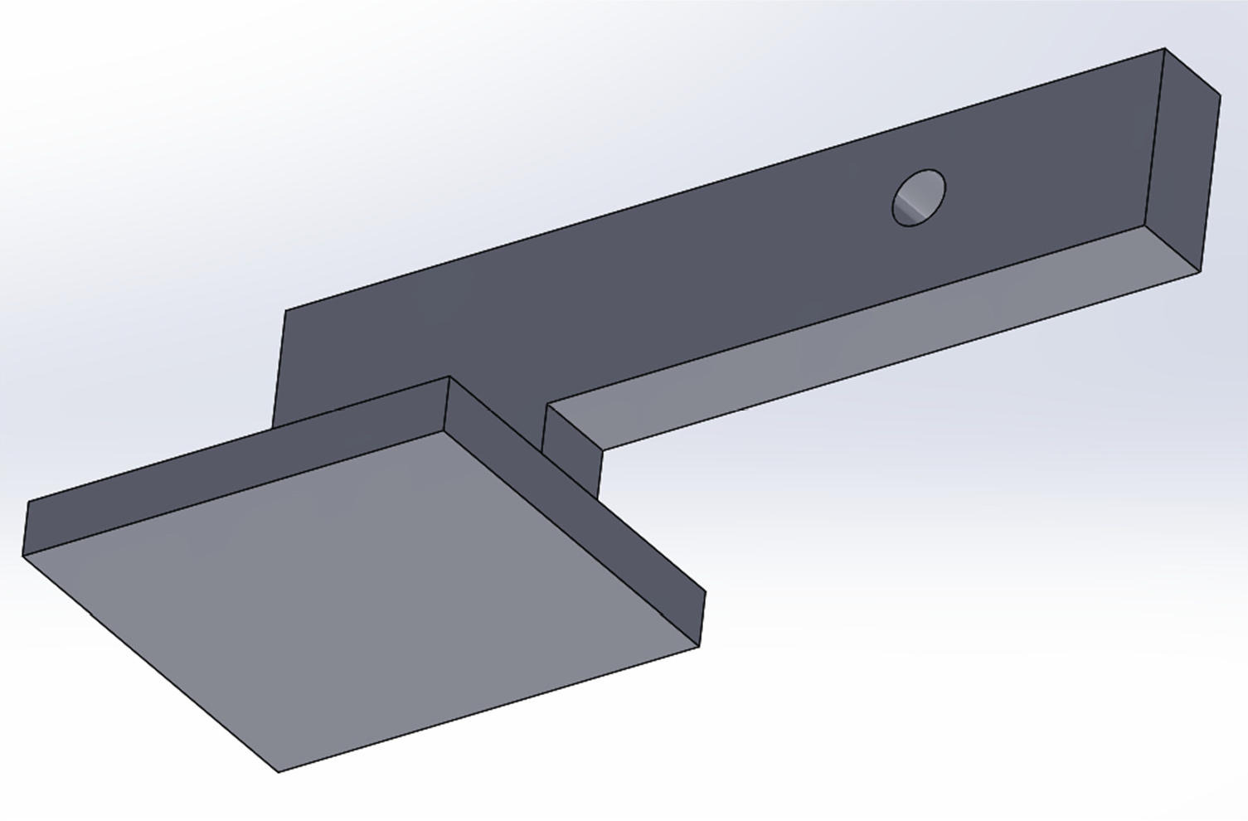
Procedure
Open the Engine_Frame part that you created for preparation for Graphics 02.
2. Rotate the part so that the bottom is visible, as in the image below.

Slide 7
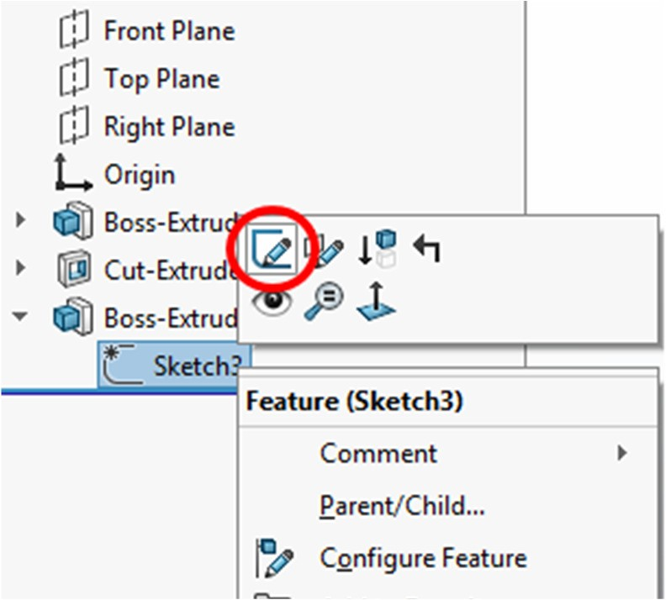
Procedure
3. In the Feature Manager Design Tree, click the drop-down arrow next to Boss-Extrude2. Right-click on Sketch3 or whichever sketch contains the bottom extrusion and select the Edit Sketch icon, which appears as a pencil and blue line.

Slide 8
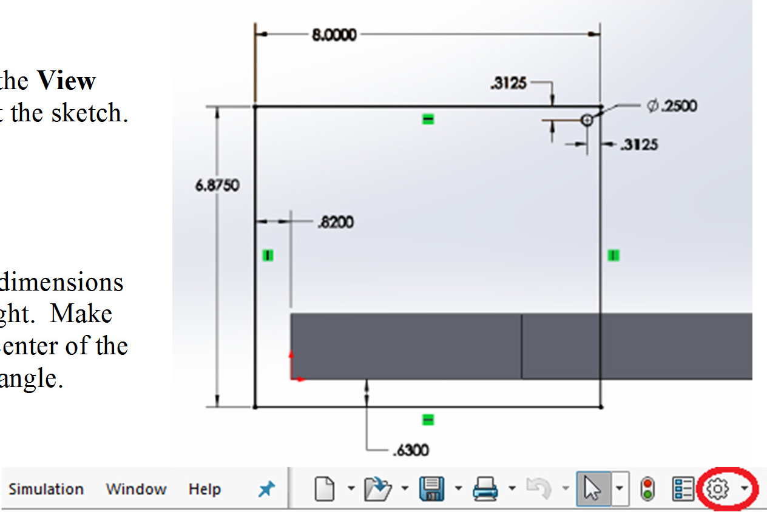
Procedure
4. Use the Normal To icon in the View Orientation mode to look at the sketch.
5. Draw a circle and apply the dimensions shown in the image to the right. Make sure to dimension from the center of the circle to the sides of the rectangle.

Slide 9
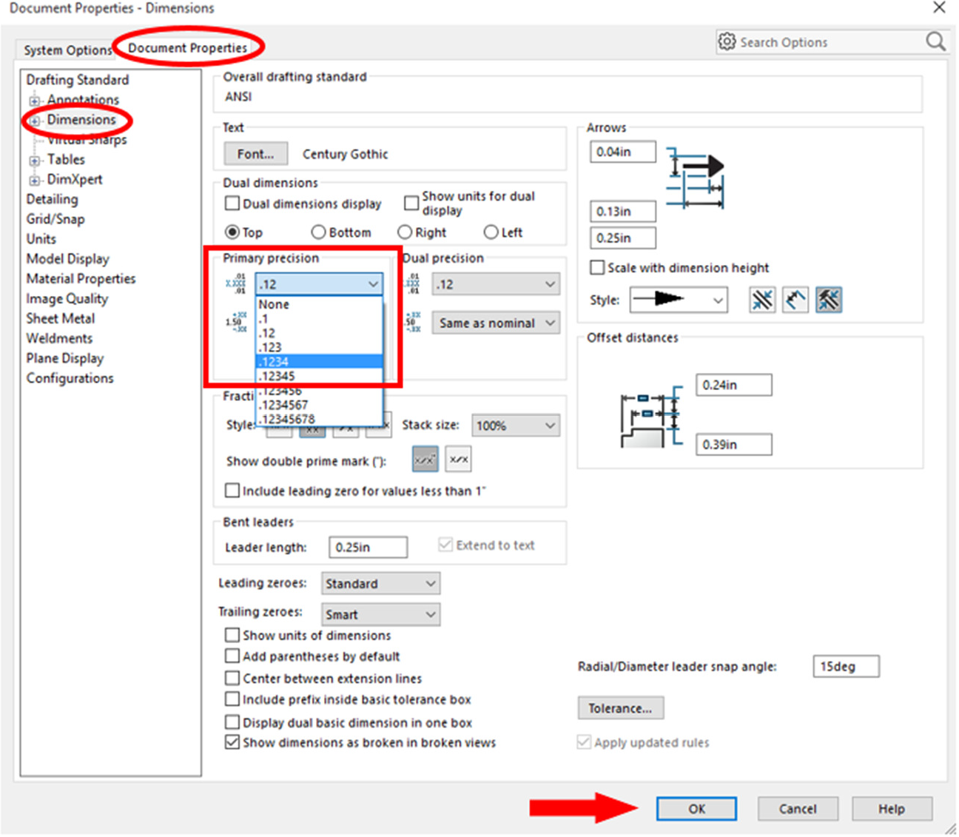
Procedure
6. As an extra note, the number of decimal places in a dimension can be changed by clicking on the Options Icon in the toolbar. Then, click on the Document Properties tab and click on Dimensions. Primary Precision changes the number of visible numbers after the decimal point. Change the precision to 4 decimal places. Then, click OK.

Slide 10
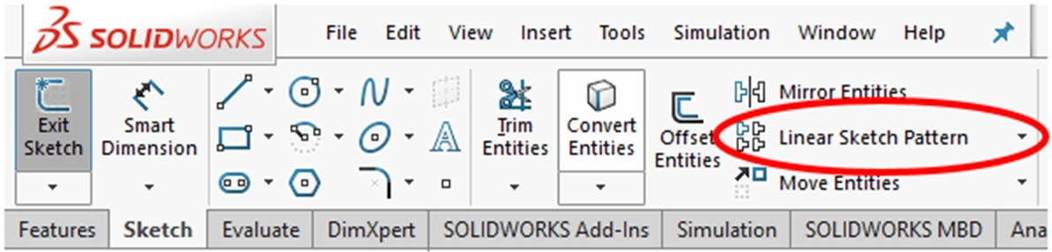
Procedure
7. On the Sketch tab, select Linear Sketch Pattern.

Slide 11
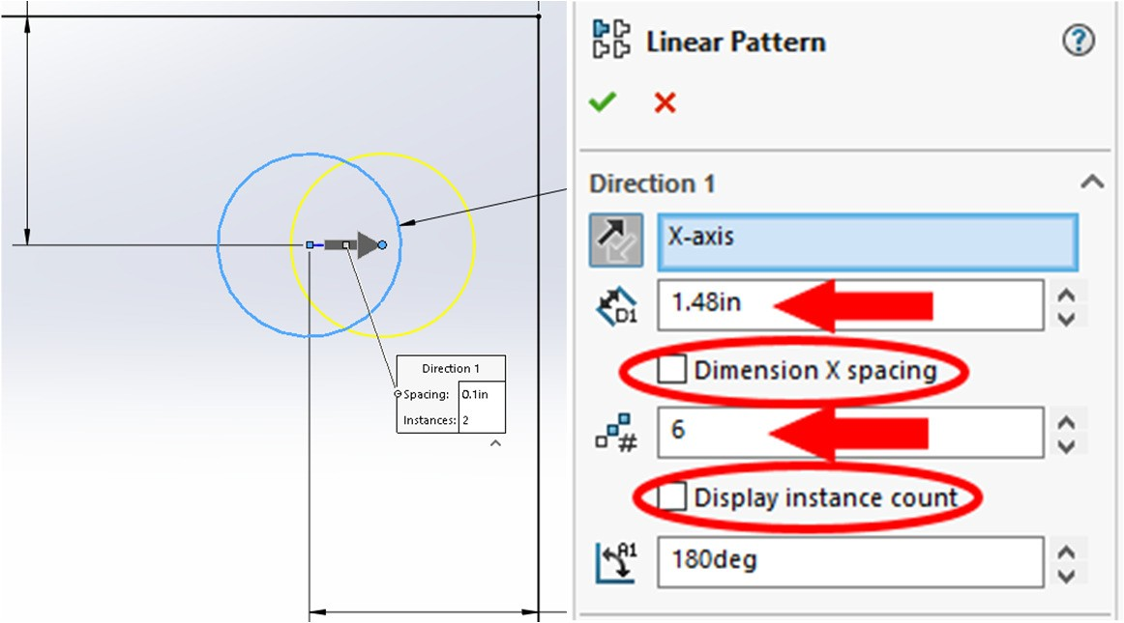
Procedure
8. Zoom in toward the circle and select the circumference of the circle. A yellow circle appears to indicate where a pattern would appear with the current settings, shown to the right. Change the D1 spacing setting to 1.48 inches and the number of instances to 6. Make sure Dimension X spacing and Display instance count are unchecked.

Slide 12
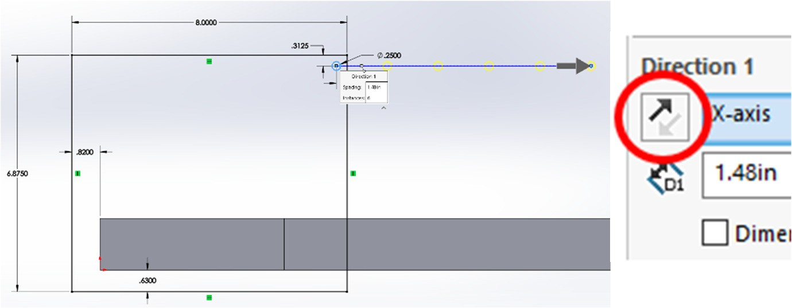
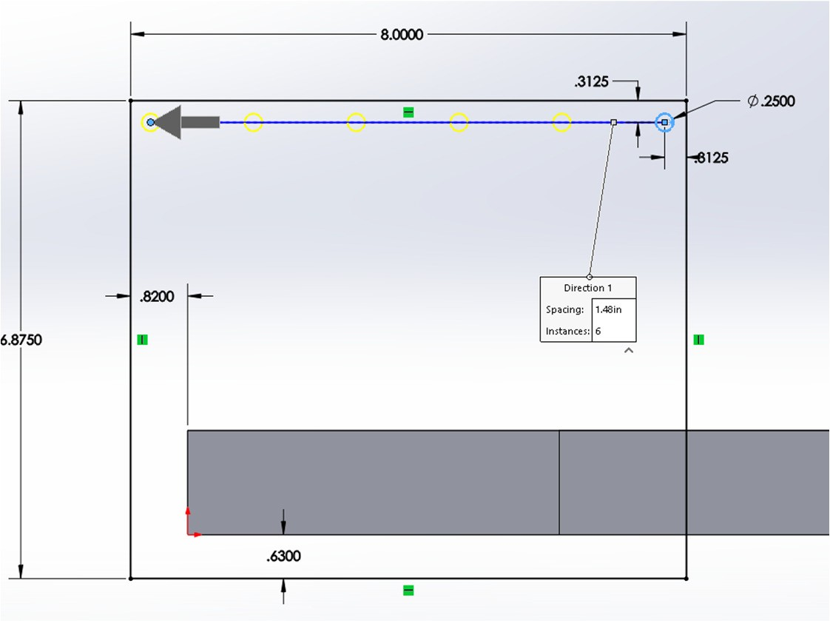
Procedure
9. If the pattern appears to extend off the right, like shown in the image to the right, select the Reverse Direction icon in the Linear Pattern panel.
10. Once the pattern extends in the correct direction, select the green checkmark or hit Enter.

Slide 13
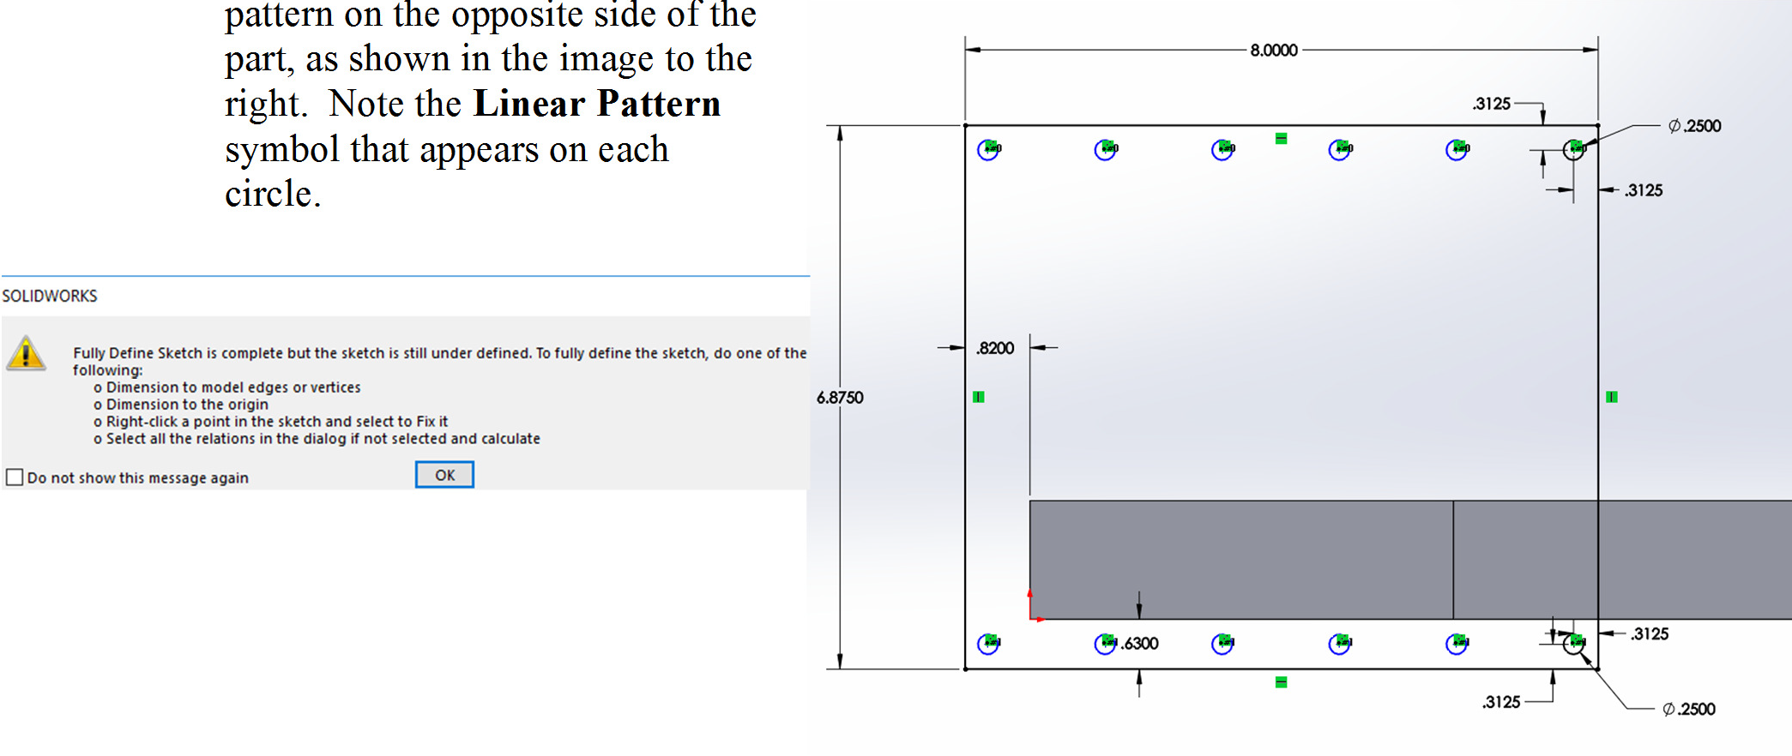
Procedure
11. Create another circle and repeated pattern on the opposite side of the part, as shown in the image to the right. Note the Linear Pattern symbol that appears on each circle.
Note that the expanded Feature Manager Design Tree will indicate that the sketch just completed is not FULLY DEFINED. For Linear Sketch Pattern even performing the Display Delete Relations / Fully Define may not remedy this SolidWorks situation. Thus, it is acceptable to leave the sketch Under Defined.

Slide 14
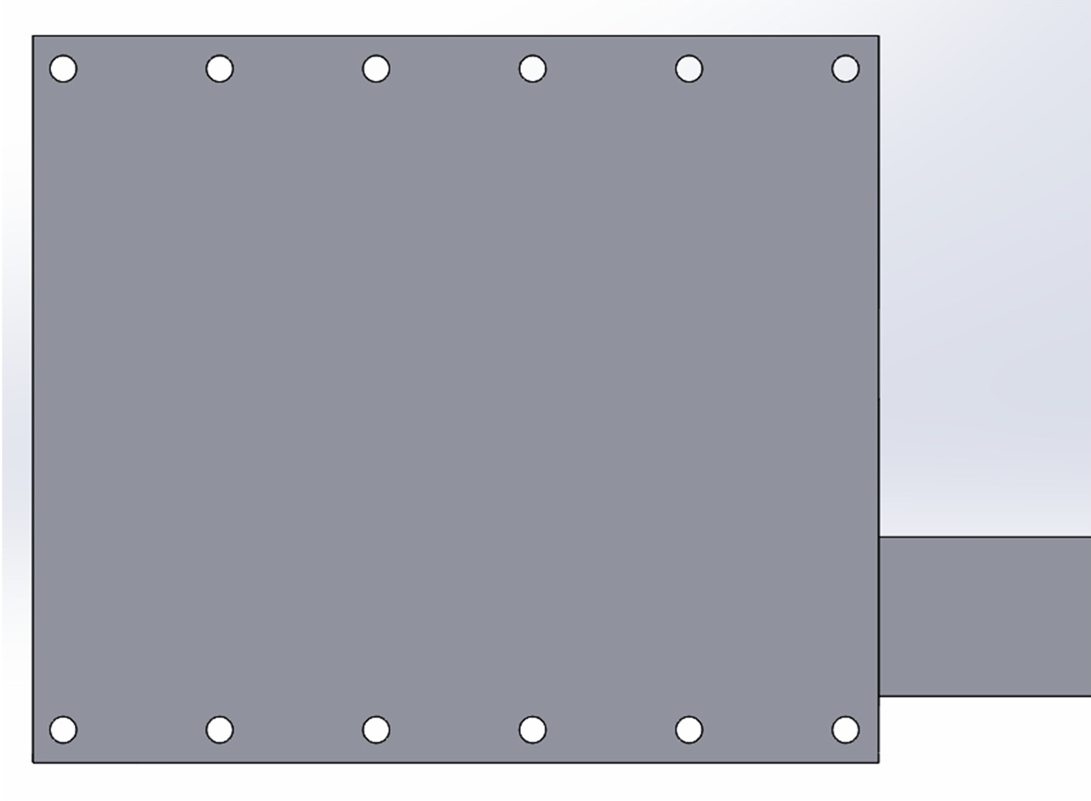
Procedure
12. Exit the sketch. The part should now look like the image shown below.

Slide 15
Deliverables:
A revised engine frame part submitted using standard submission practices for parts.

